Slide 1

Solving the Maze problem with ILP
Angelo Andreussi, Alex Della Schiava, Claudia Maußner

Slide 2
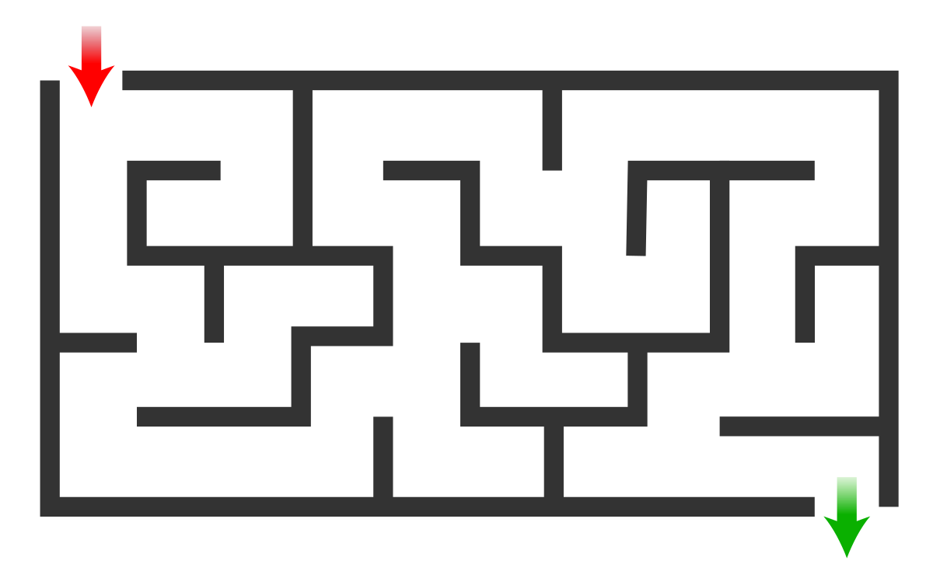
The Maze Problem
A fairly simple problem.
Find a path from point A to point B in a labyrinth-shaped map.
Can be solved with a huge variety of classical algorithms
An example of a Maze

Slide 3
Our tools
HYPER (Bratko, 1999): Based on Top-down search in the hypothesis space.
Metagol (Cropper, Muggleton, 2016): Based on meta-interpretative learning.
ILASP (Law, 2018): Inductive Logic Programming in the context of Answer Set Programs (ASP).

Slide 4
Our goals
Of course, solving the Maze problem.
In some cases, directly through ILP;
Otherwise, using the code learned through ILP.
Comparing HYPER, Metagol and ILASP.
Different systems produce different performances.
Not only, they can also lead to huge differences in the approach of the problem.
Further studying and analyzing these ILP techniques.

Slide 5
Metagol

Slide 6
Brief recap
Four key components:
Metarules. (Language Bias)
Background Knowledge.
Positive examples.
Negative examples.
Learning procedure:
Select a positive example to be proven.
Prove it through either the existing background knowledge or clauses previously induced.
(If step 2 did not work) Unify the example with the head of a metarule and repeat the process for each of the atoms in the body.
Once the hypothesis is complete, check its consistency. If negative examples are covered then backtrack.

Slide 7
Learning to walk
Goal: Learn to move to an adjacent, legal cell. (Predicate move/2).
Background Knowledge:
inc_x/2; dec_x/2; inc_y/2; dec_y/2;
legal_position/1: Checks whether a cell is in bounds and free from obstacles.
Metarules:
metarule(ident,[P,Q],[P,A,B],[[Q,A,B]]).
metarule(postcon,[P,Q,R],[P,A,B],[[Q,A,B],[R,B]]).
metarule(i_postcon,[P,Q,R],[P,A,B],[[R,B],[Q,A,B]]).
Positive examples:
One legal move for each direction (up, down, left, right).
Negative examples:
One illegal move for each direction.

Slide 8
The power of metarules
Using postcon:
move(A,B):-inc_x(A,B),legal_position(B).
move(A,B):-inc_y(A,B),legal_position(B).
move(A,B):-dec_x(A,B),legal_position(B).
move(A,B):-dec_y(A,B),legal_position(B).
Using i_postcon:
move(A,B):-legal_position(B),move_1(A,B).
move_1(A,B):-inc_x(A,B).
move_1(A,B):-inc_y(A,B).
move_1(A,B):-dec_x(A,B).
move_1(A,B):-dec_y(A,B).
i_postcon is able to «invent» the predicate adjacent/2.

Slide 9
The power of metarules
postcon | i_postcon
0.047 seconds | 0.121 seconds
This comparison highlights the impact that one added clause can have on the performance.
Tradeoff: More expressive solutions require a larger search space.
(Timings are mean values from 10 runs).

Slide 10
Learning to travel
Goal: Learn to move from two distant cells in the Maze without going through illegal cells. (Predicate reach/2).
Background Knowledge:
move/2 (Learned from «learning_to_walk»).
Metarules:
metarule(recursion,[P,Q],[P,A,B],[[Q,A,C],[P,C,B]]).
metarule(ident,[P,Q],[P,A,B],[[Q,A,B]]).
Positive examples:
reach((1,1), (2,1)).
reach((1,1), (2,5)).
Negative examples:
NONE: Illegal behaviour is already forbidden by the background knowledge.
What if we remove this?

Slide 11
Learning to travel (from scratch)
Goal: Learn to move from two distant cells in the Maze without going through illegal cells. (Predicate reach/2).
Background Knowledge:
inc_x/2; dec_x/2; inc_y/2; dec_y/2;
legal_position/1.
Metarules:
metarule(ident,[P,Q],[P,A,B],[[Q,A,B]]).
metarule(ident2,[P,Q],[P,A,B,[A,B]],[[Q,A,B]]).
metarule(prepostcon,[P,Q,R],[P,A,B],[[R,B],[Q,A,B]]).
metarule(recursion,[P,Q,R],[P,A,B,[A|L1]],[[R,B],[Q,A,C],[R,C],[P,C,B,L1]]).
Positive examples:
4 examples representing a single step (one for each direction).
1 example representing a path which uses all 4 moves (reach((3,1),(4,5)))
Negative examples:
4 examples of single steps going out of bounds.
4 examples of single steps going into obstacles.

Slide 12
The result
reach(A,B,[A,B]):-reach_1(A,B).
reach_1(A,B):-legal_position(B),reach_2(A,B).
reach_2(A,B):-inc_x(A,B).
reach_2(A,B):-dec_y(A,B).
reach_2(A,B):-inc_y(A,B).
reach_2(A,B):-dec_x(A,B).
reach(A,B,[A|C]):-legal_position(B),reach_2(A,D),legal_position(D),reach(D,B,C).
Through predicate invention we are learning move/2.

Slide 13
Other tasks
learning_to_travel_memory.pl: Same as «learning to travel» but also keeps track of the path in a list.
learn_to_win.pl: Solving the Maze problem directly through ILP. Gives a «sequence of predicates» to reach the goal cell from the start cell.

